Slide 1


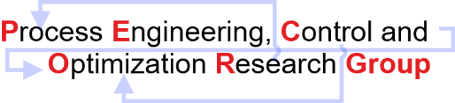
Artificial Neural Network
Model
All the results obtained are attached in the slides shared.
The slides contain the tables of features selected and their corresponding accuracy obtained while training ANN/Random Forest Classifier or feature importance obtained while employing unsupervised learning methods on datasets.
The June FFSA Updated slides has the results which showed improvement in accuracy.
Discipline of Chemical Engineering,
Indian Institute of Technology Gandhinagar,
Palaj, Gujarat – 382055
India

Slide 2
Artificial Neural Network
Case Study 1
Forward Selection Algorithm implemented on Random Forest Classifier.
Statistical Features obtained after running the forward selection algorithm starting with an empty set of features.
Statistical Features Selected from Forward Selection Algorithm | Corresponding increase in accuracy
MOLD BROAD FACE 2 INLET OUTLET WATER TEMP. DELTA MEAN | 67.23%
SEG 7+8 BOTTOM SECONDARY COOLING WATER FLOW ACTUAL MEAN | 76.47%
PER_S MEAN | 77.31%
MOLD NARROW FACE COOLING WATER INLET TEMP MEAN | 81.51%

Slide 3
Artificial Neural Network
Case Study 2
Forward Selection Algorithm implemented on ANN.
Statistical Features obtained after running the forward selection algorithm starting with an empty set of features.
Statistical Features Selected from Forward Selection Algorithm | Corresponding increase in accuracy
MOLD BROAD FACE 2 INLET OUTLET WATER TEMP. DELTA MEAN | 71.43%
SEG 7+8 BOTTOM SECONDARY COOLING WATER FLOW ACTUAL MEAN | 73.11%

Slide 4
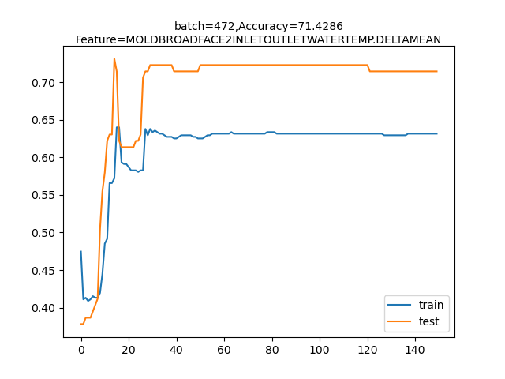
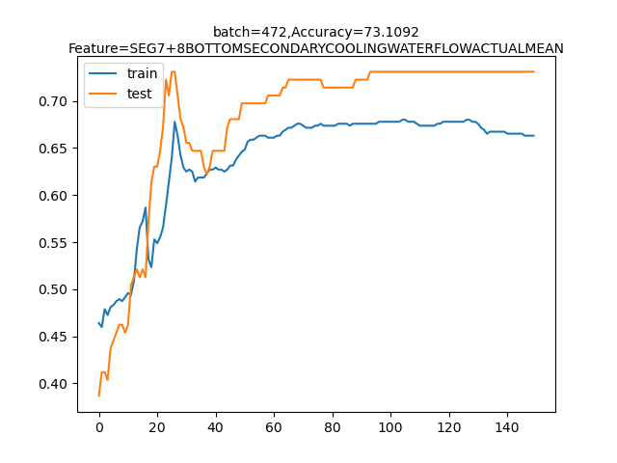
Artificial Neural Network
Case Study 2
Forward Selection Algorithm implemented on ANN.
Stability and Convergence analysis.

